Slide 1
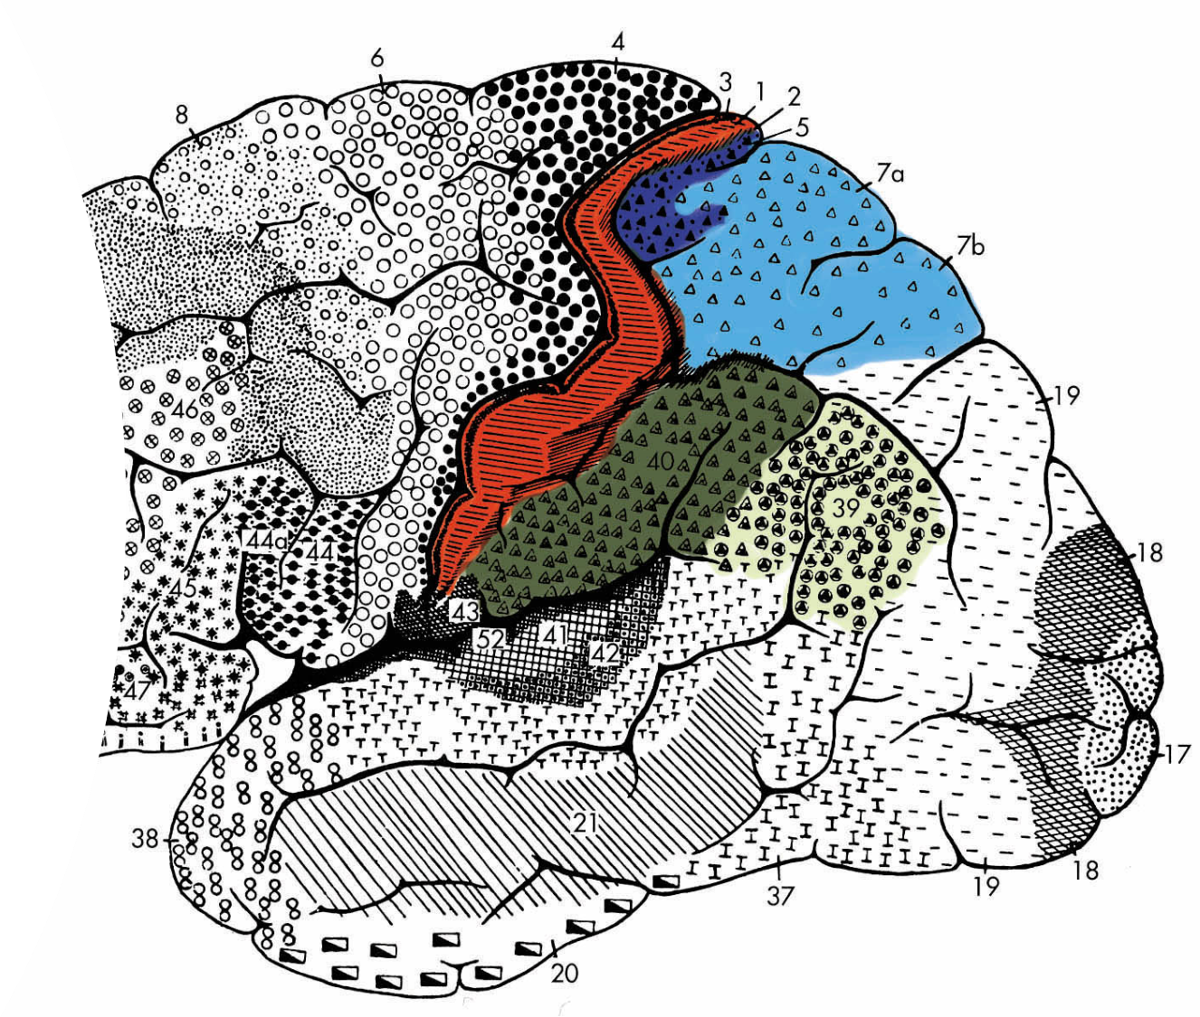
Parietal Cortex

Slide 2
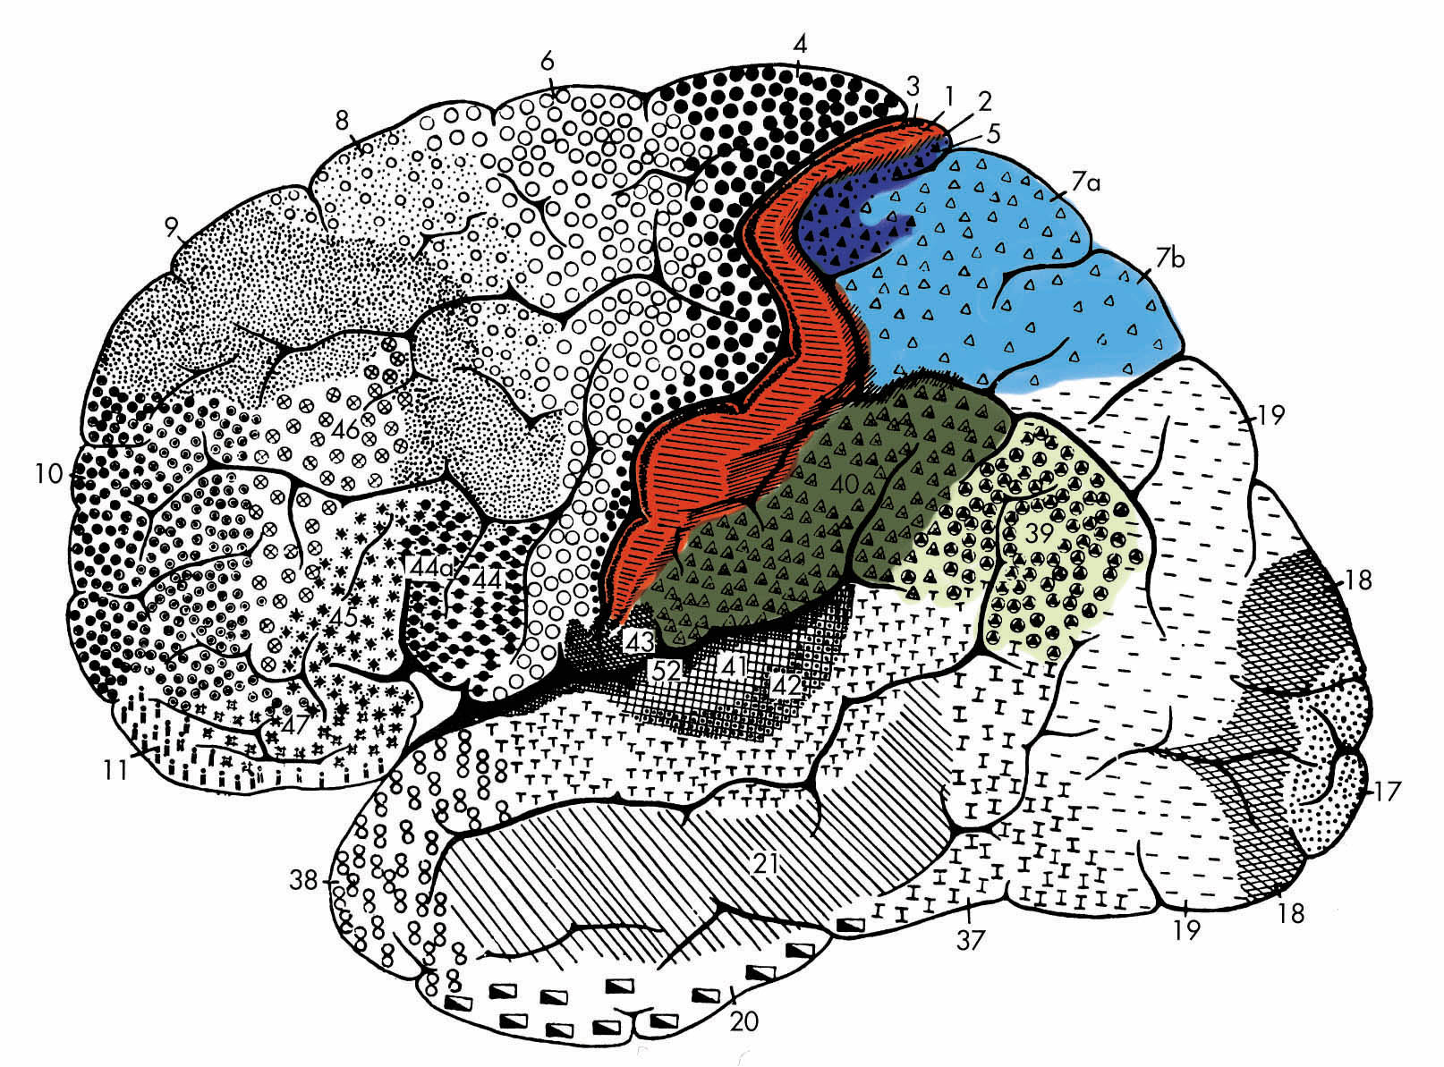
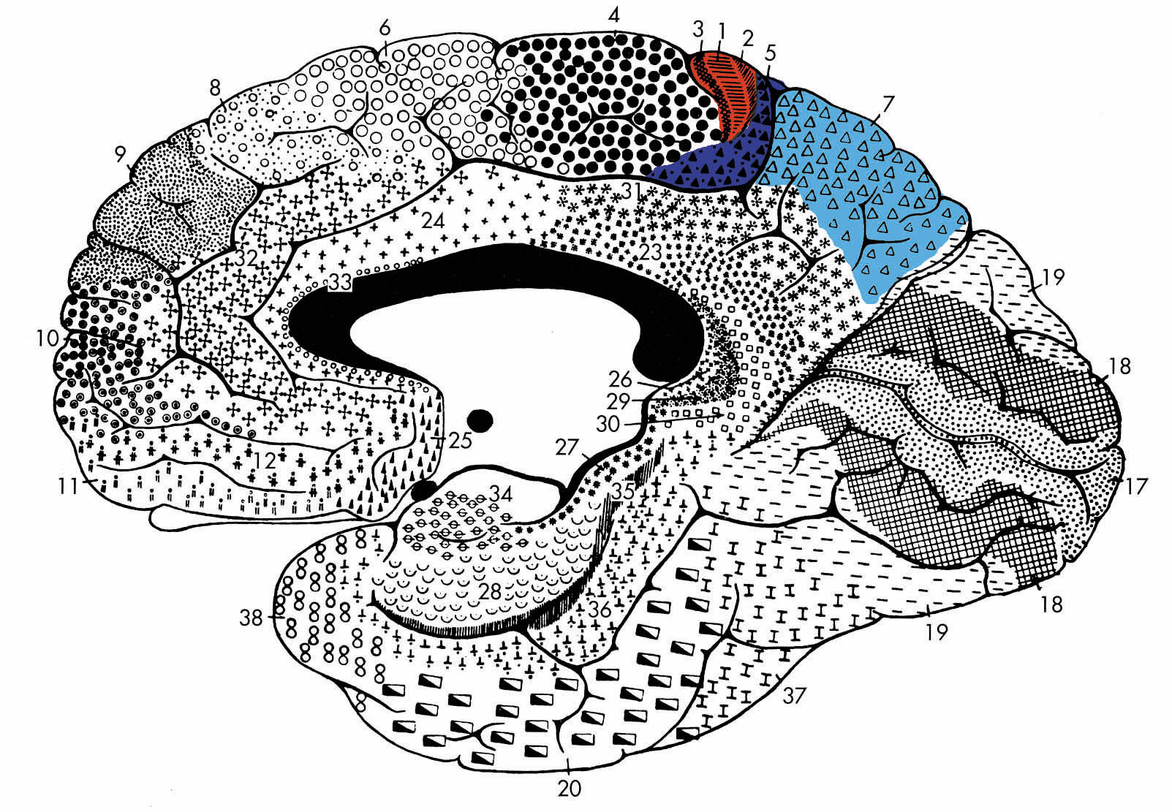
Parietal cortex includes
BA 3, 1 & 2
Somatosensory cortex
BA 5 & 7
Superior
parietal lobule
BA 39 & 40
Inferior
parietal lobule

Slide 3
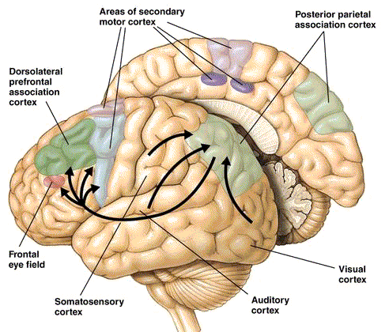
Parietal Cortex and Sensory Information
Posterior parietal cortex receives polymodal inputs
Visual (dorsal stream)
Auditory
Somatosensory
Intermodal mixing (BA 39, 40)

Slide 4
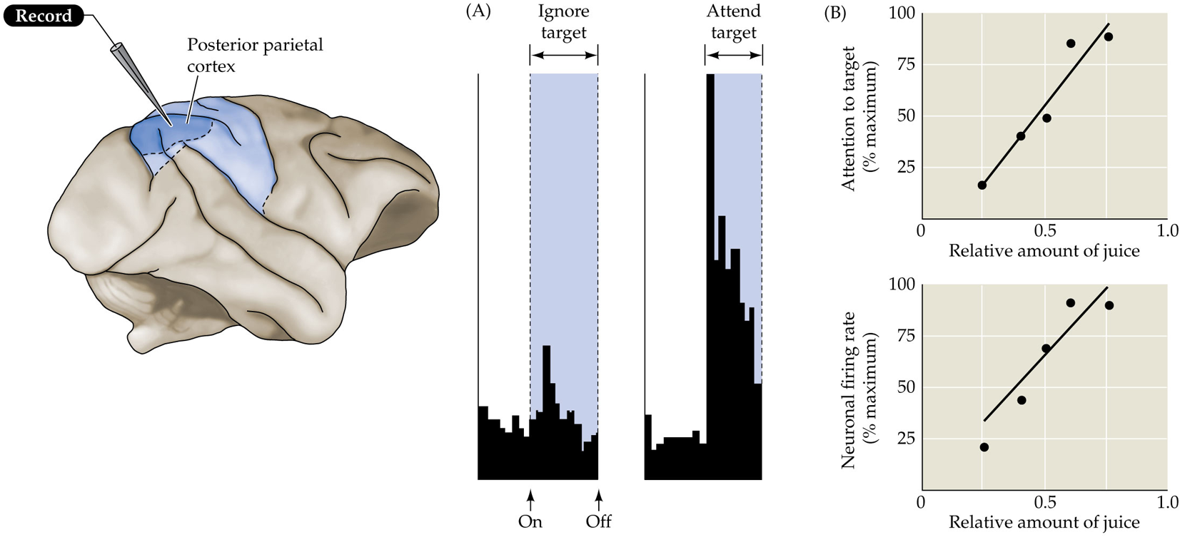
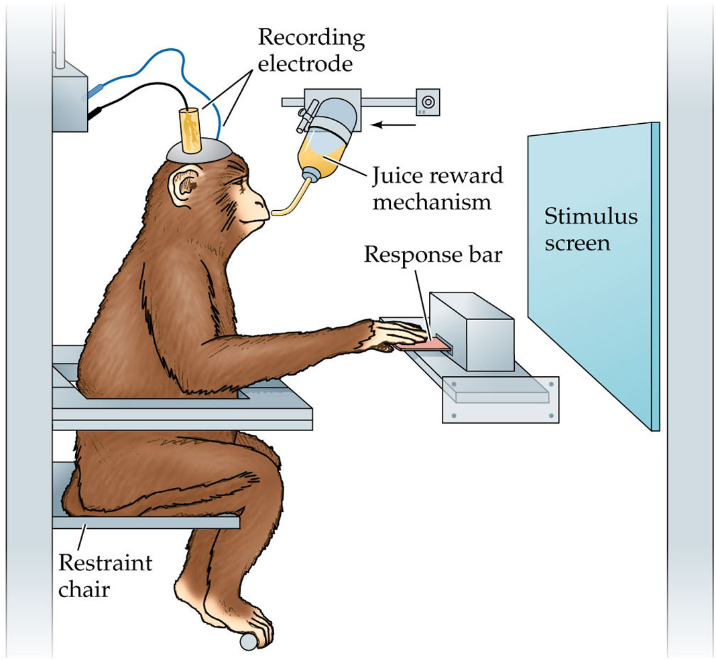
Neural Activity in Parietal Cortex Associated with Attention

Slide 5
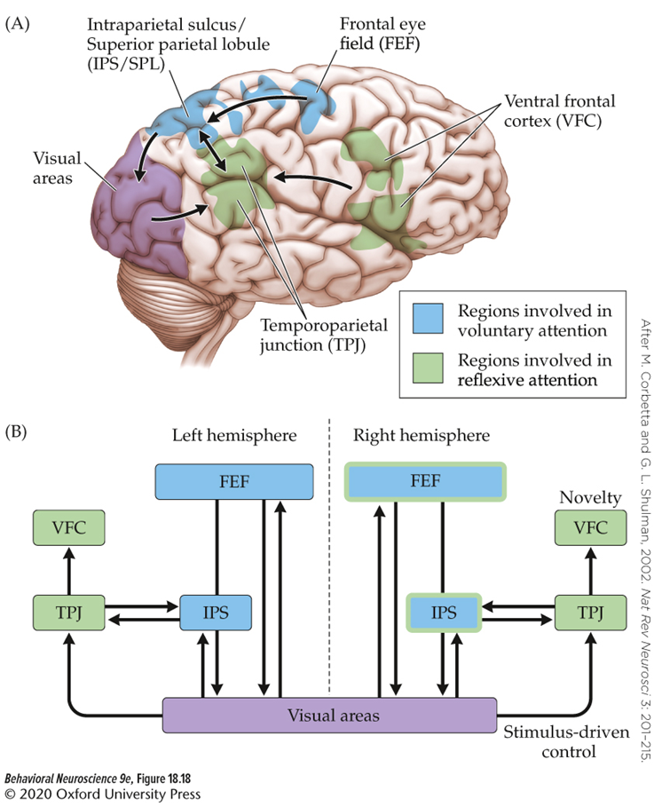
Attention Orientation and Parietal Cortex
IPS orients attention towards salient stimuli.
  Voluntary attention
TPJ increases activity in response to unexpected salient stimuli.
  Reflexive attention

Slide 6
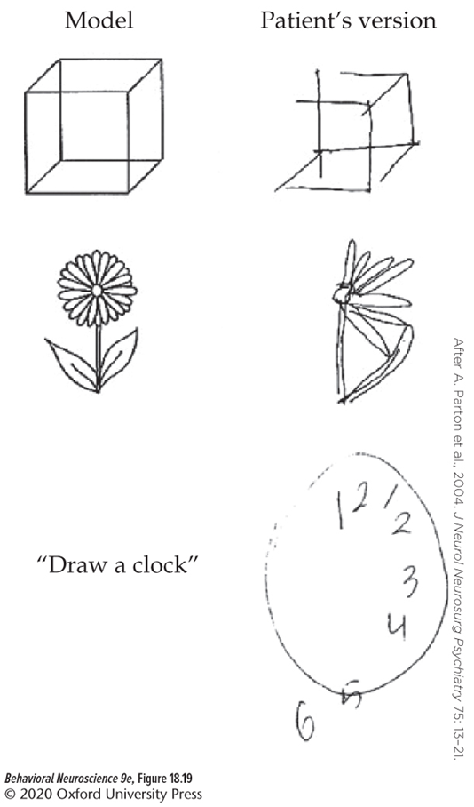
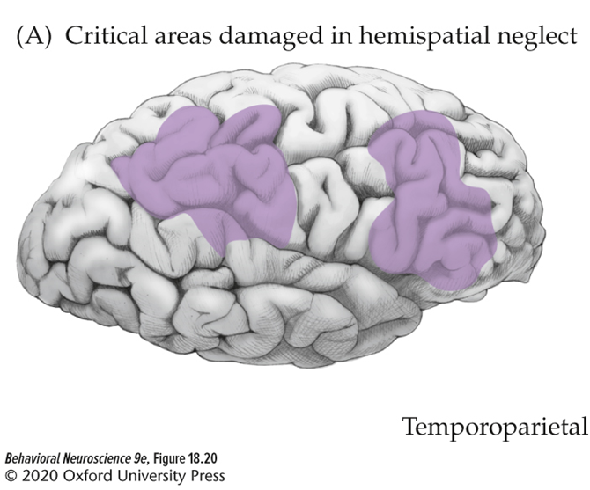
Damage to Parietal Lobe: Contralateral Neglect
A syndrome in which a person fails to pay attention to objects presented to one side of the body.
Linked to damage of regions related to attention control, especially right inferior parietal cortex

Slide 7
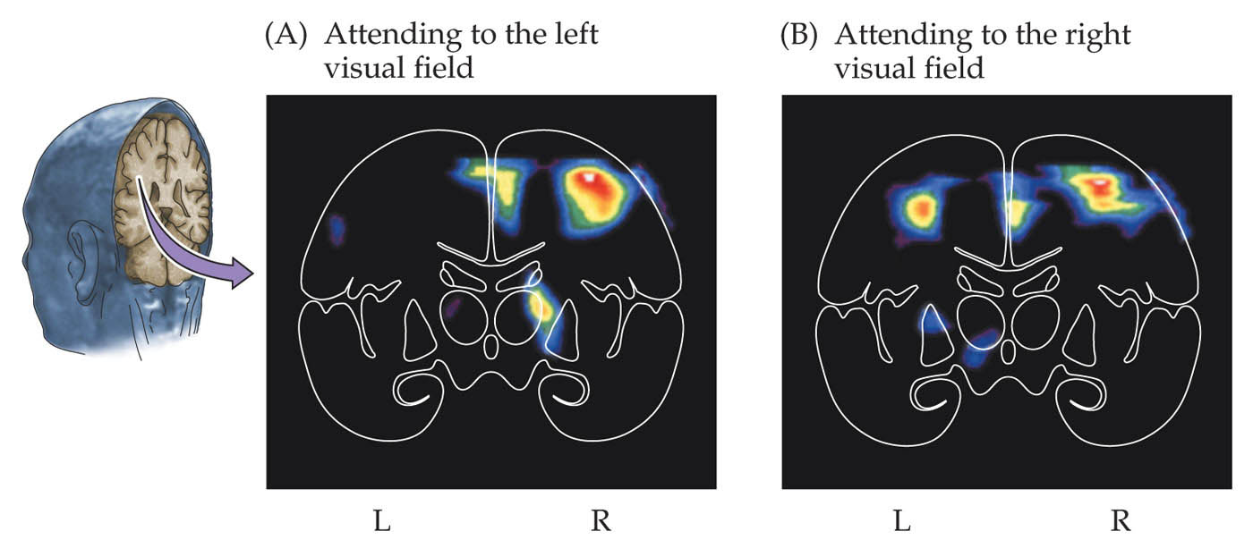
Functional asymmetry in parietal cortex is thought to contribute to left neglect
Attention to right visual space is represented on both sides.
Attention to left visual space is represented only in right parietal cortex

Slide 8
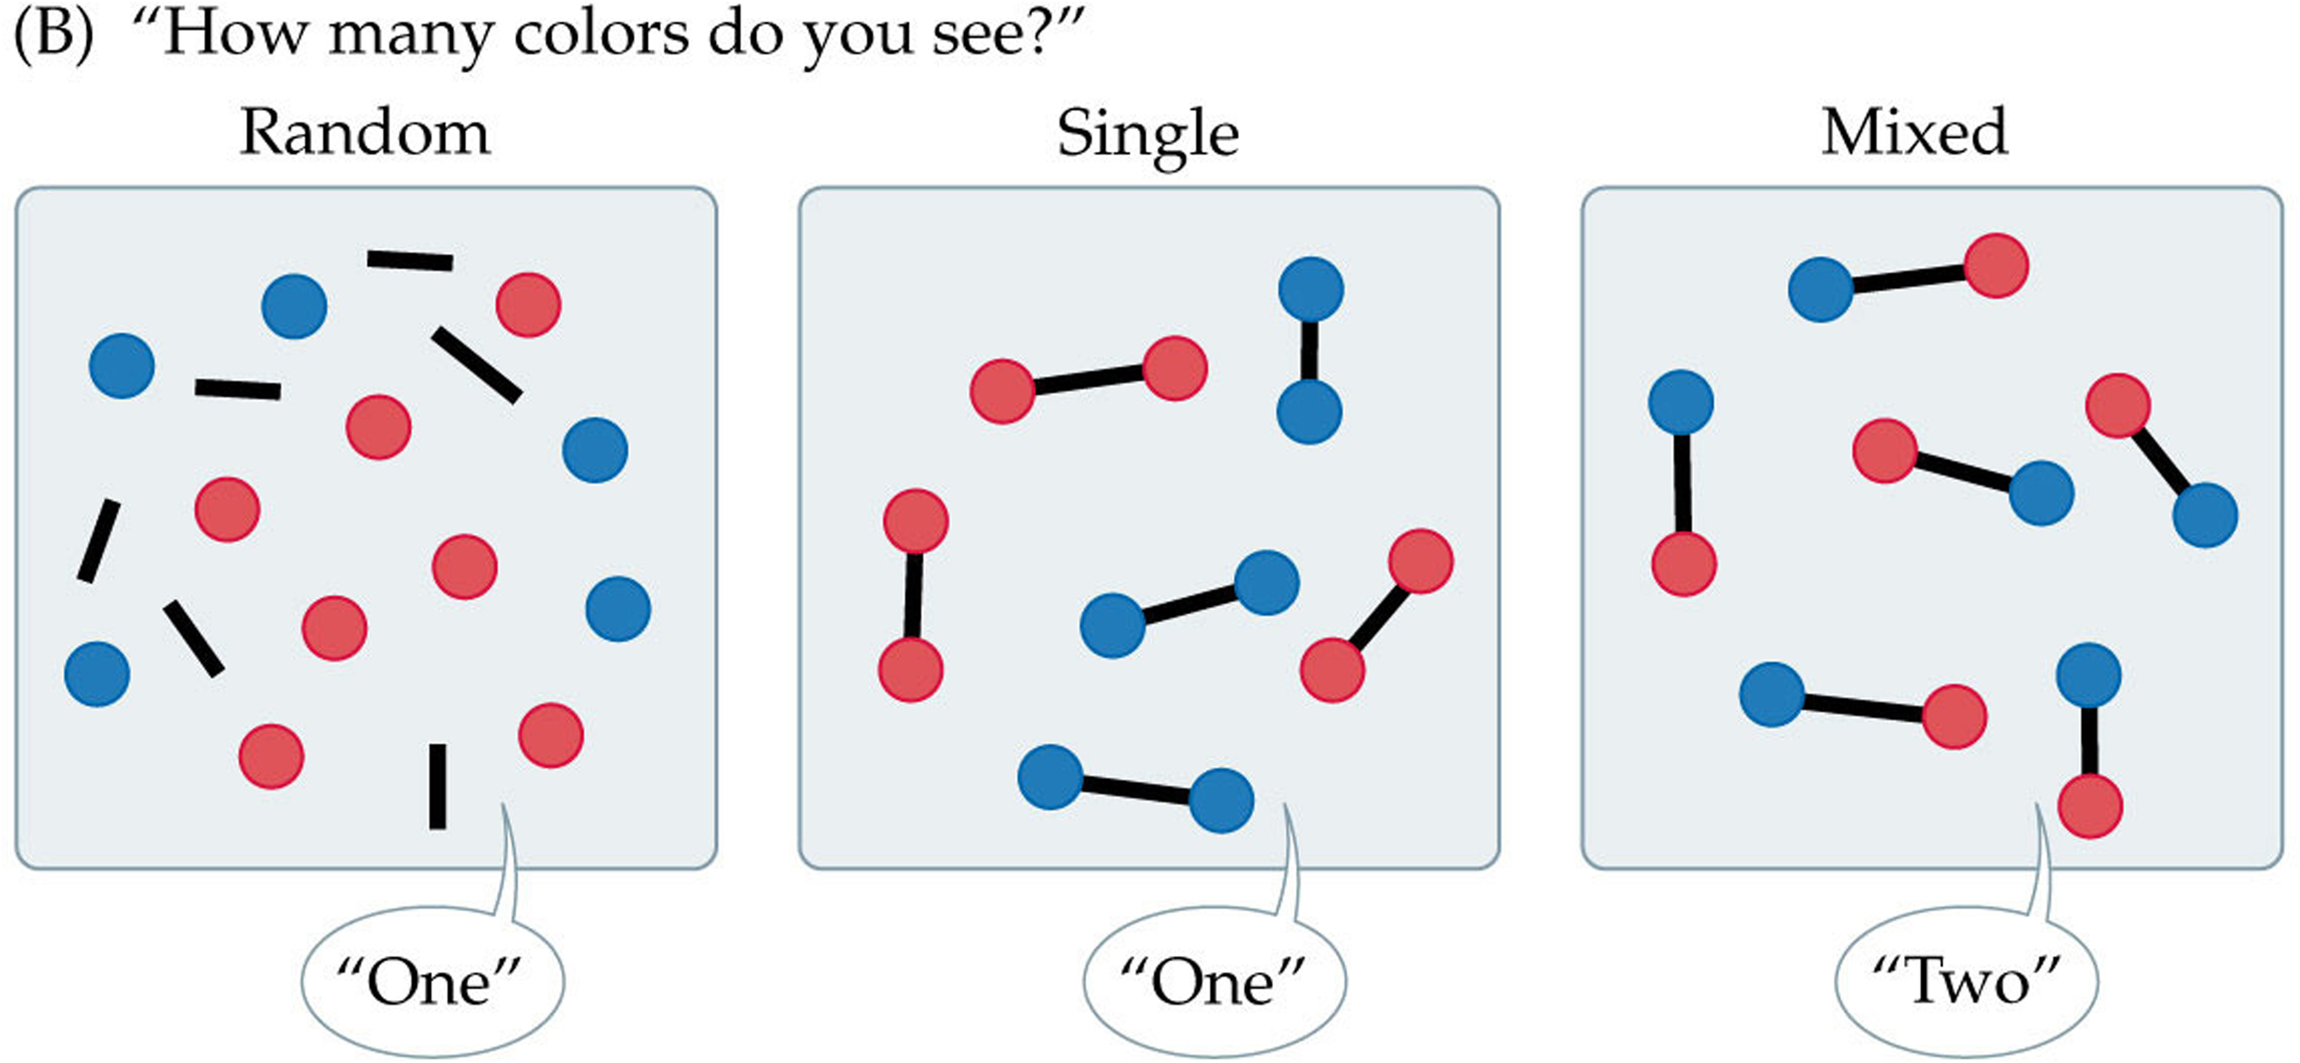
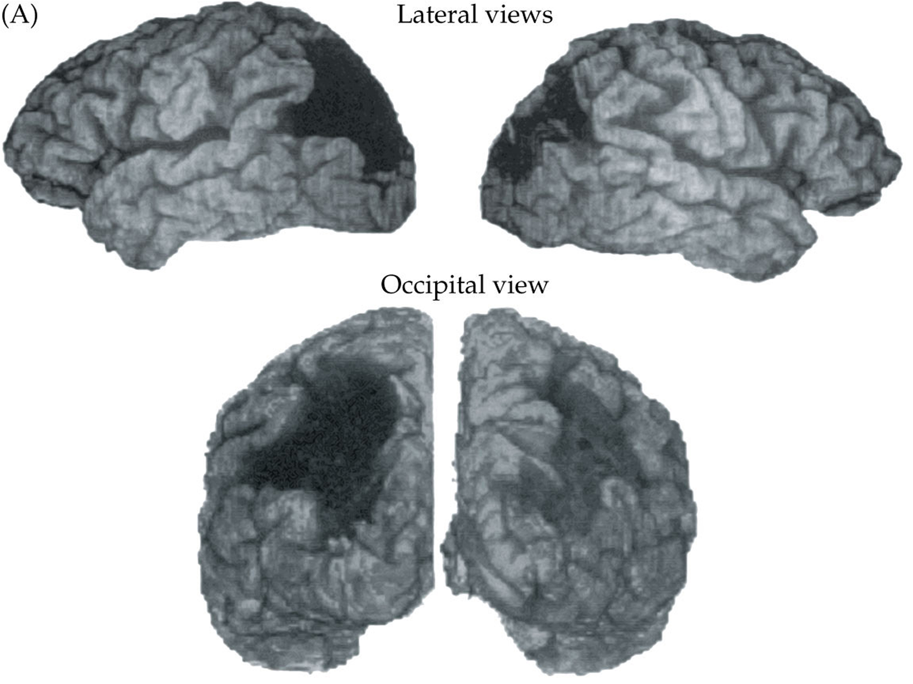
Balint’s syndrome
Bilateral damage to posterior parietal cortex
Symptoms include:
  Simultanagnosia
  Optic ataxia
  Oculomotor apraxia

Slide 9
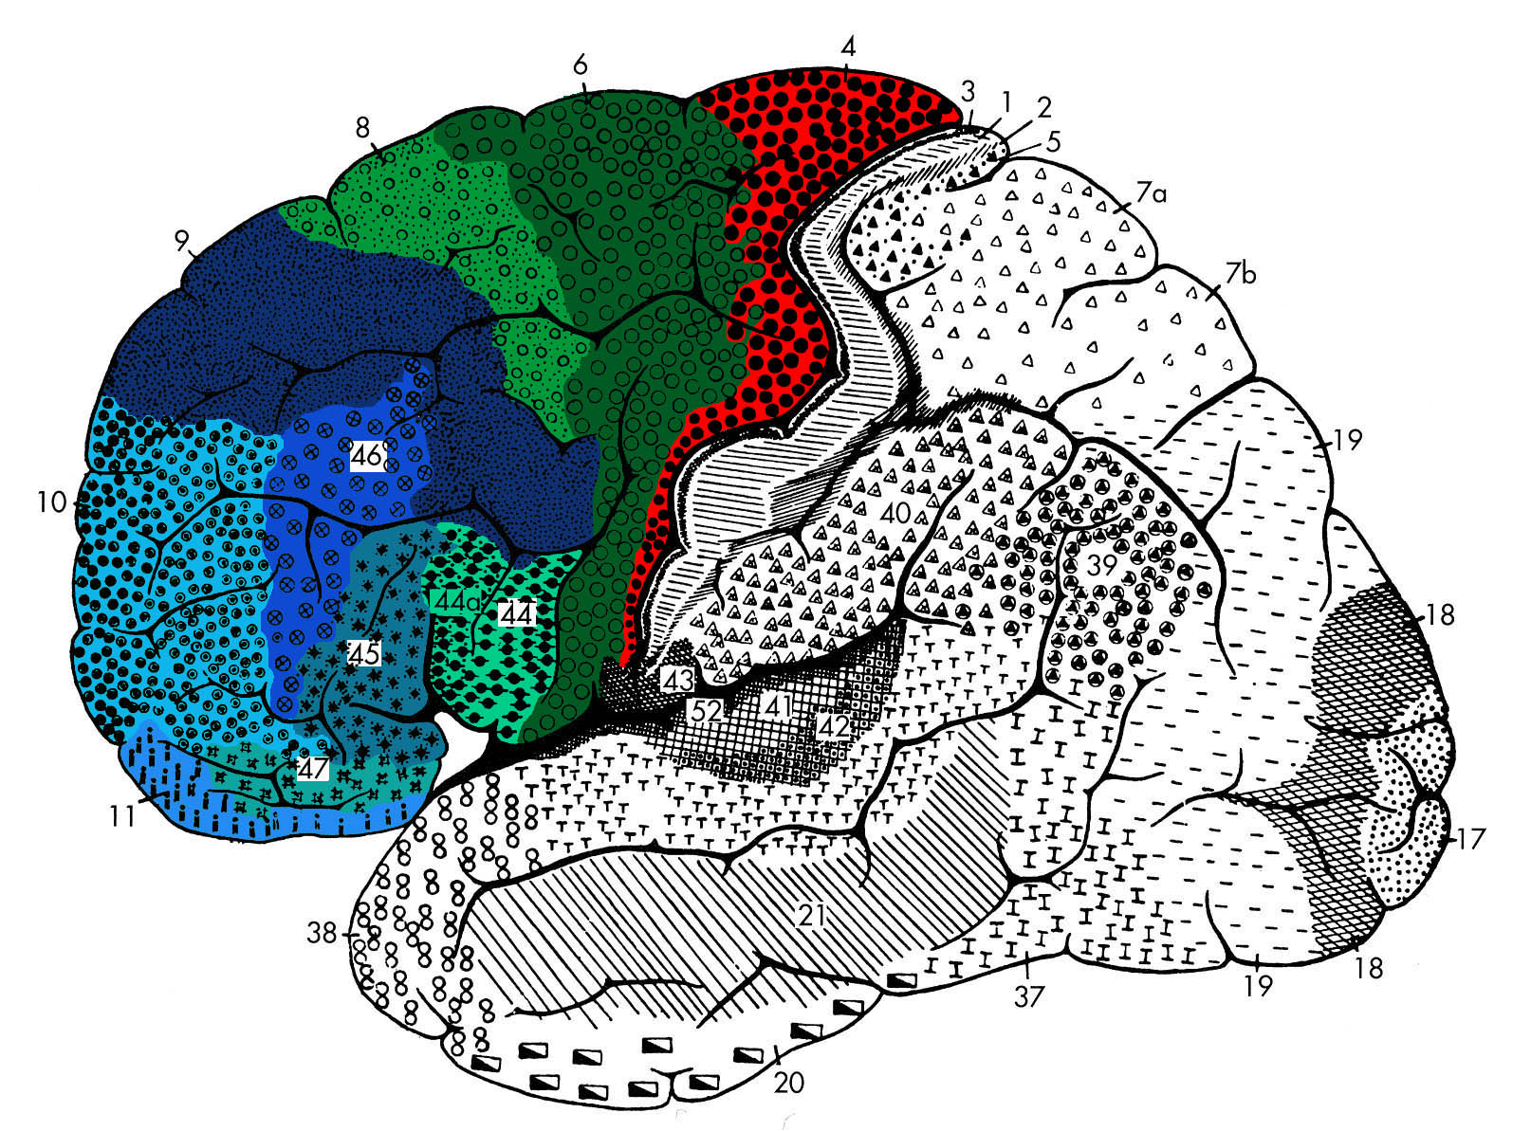
Frontal Cortex

Slide 10
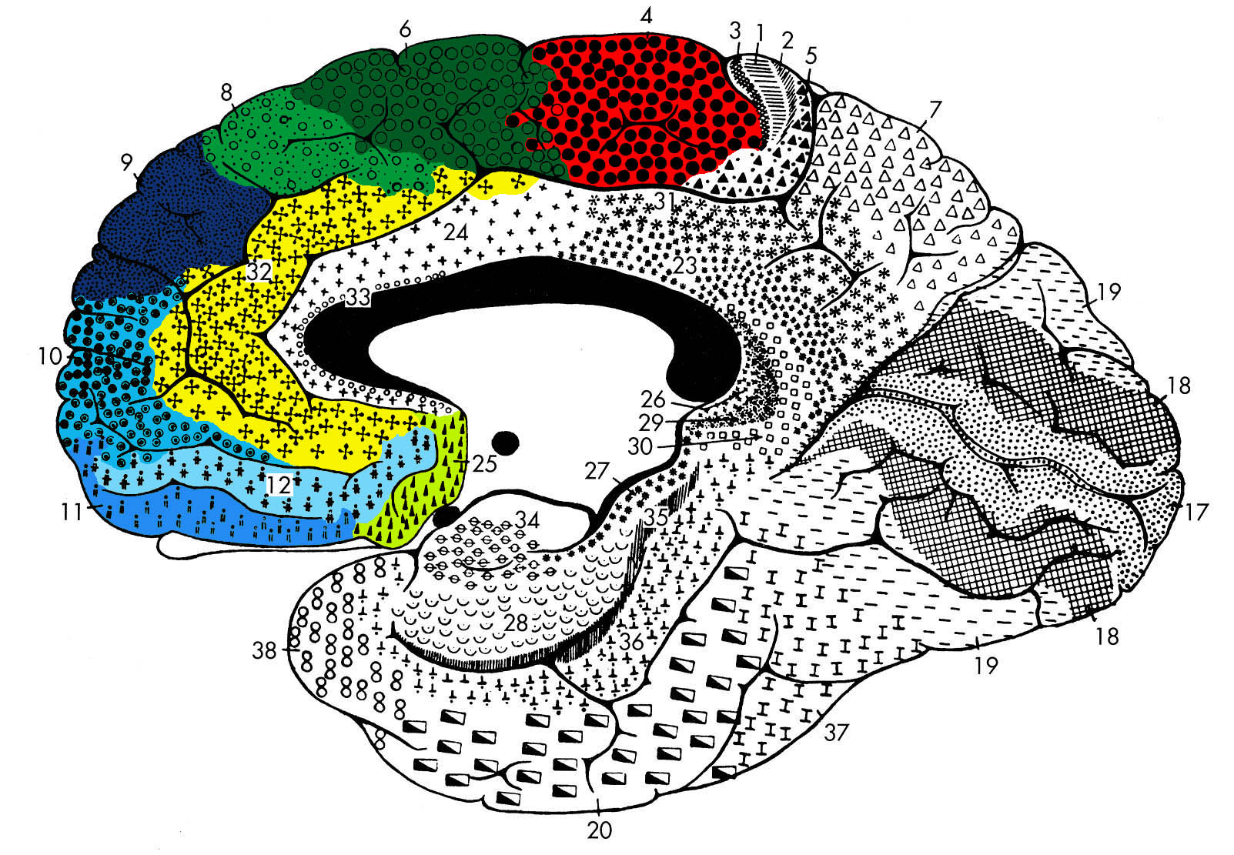
Frontal cortex includes
BA 4
Primary motor cortex
BA 6 & 8
Premotor cortex
Supplementary motor cortex
BA 44 (& 45)
Broca’s area
Prefrontal cortex (PFC)

Slide 11
Prefrontal (PFC) cortex includes
BA 9 & 46
Dorsolateral PFC (DLPFC)
Ventrolateral PFC (VLPFC)
BA 44, 45 & 47/12
BA 10, 11, 47/12, 13 & 14
Orbital frontal cortex (OFC)
Ventromedial prefrontal (VMPFC)
BA 24, 25 & 32
Anterior cingulate cortex (ACC)
Dorsomedial PFC (DMPFC)
BA 31 & 23
Posterior cingulate cortex (PCC)

Slide 12
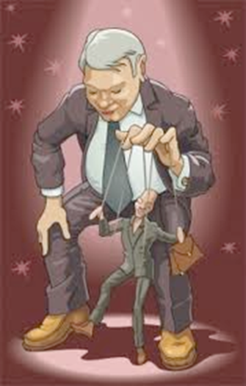
Executive Functions
High-level cognitive processes that control and organize lower-level cognitive functions in line with our thoughts and feelings.
Relies on 3 essential processes:
  Shifting: switching from one mode of thinking to another
  Updating: revising a cognitive plan based on new information and contents of working memory
  Inhibition: inhibiting responses that would compromise or interfere with the plan

Slide 13
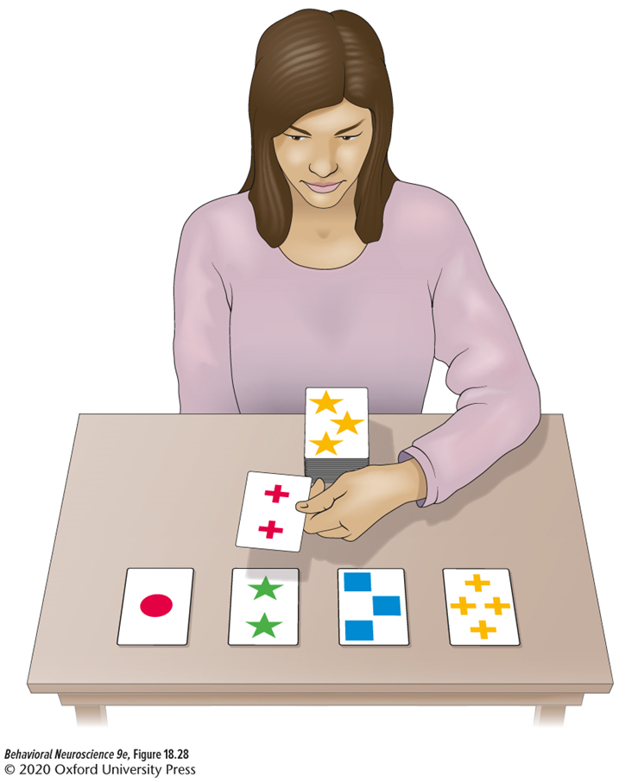
The Wisconsin Card sorting task
Participants sort cards based on similar features.
The rule for which feature to sort by changes at random.
Tests shifting, updating, and inhibition.

Slide 14
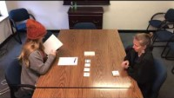
Wisconsin Card sorting test (WCST)
https://www.youtube.com/watch?v=xFVq0xbjXv4

Slide 15
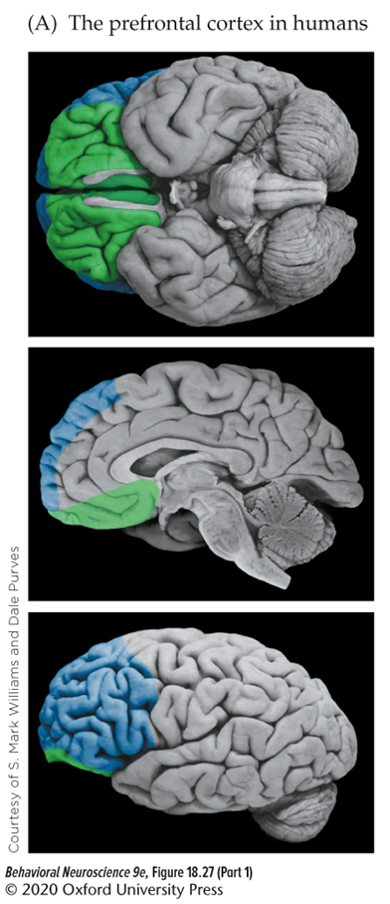
Prefrontal Cortex and executive function
Identifies information that is goal/task-relevant and determines a task set.
Functional subdivisions:
  Dorsolateral prefrontal cortex (dlPFC): updating and shifting
  Medial prefrontal cortex (mPFC): using memories in a goal driven manner
  Orbitofrontal cortex (OFC): value-based decision making and inhibition

Slide 16

A Neural basis for decision making
Two main underlying systems:
  A valuation system to rank choices: ventromedial prefrontal cortex, orbitofrontal cortex, and the dopamine-based reward system.
  A choice system to consider alternatives and make the decision: dorsolateral prefrontal cortex, dorsal anterior cingulate cortex, and parietal regions.

Slide 17
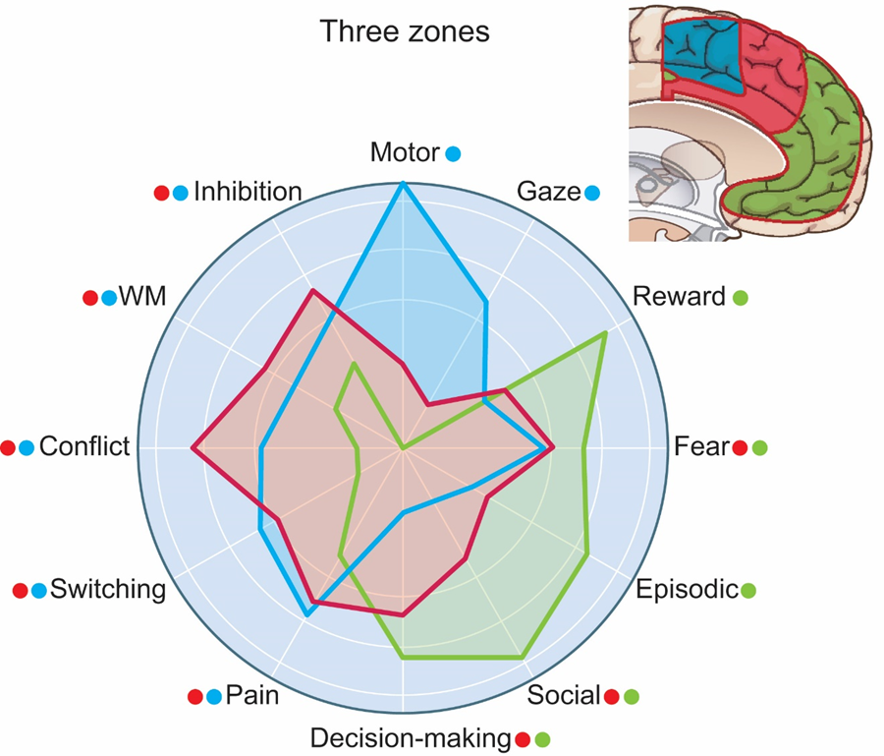
Cingulate cortex
The cingulate cortex, is crucial in:
  evaluating the utility of actions that have emotional significance
  integrating motivational aspects of behavior
Subdivisions:
  Posterior (blue): motor functions
  Middle (red): cognitive control
  Anterior (green): emotion

